Slide 1

Ipse
Your self-sovereign identity

Slide 2

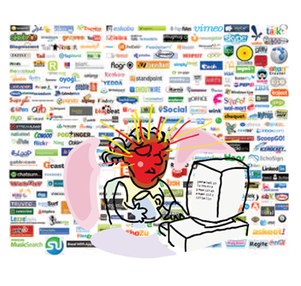
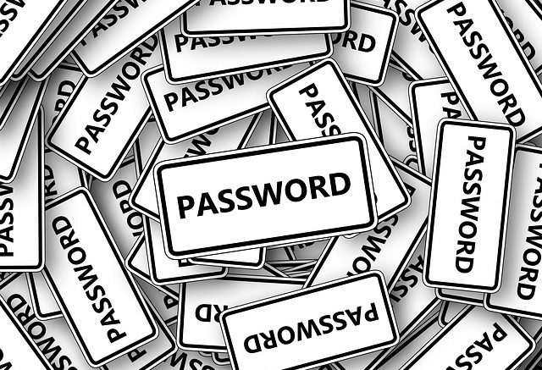

The current situation with digital identity
Users need to remember dozens of accounts and passwords
Managing your online identity is complicated
Millions of accounts are hacked each year

Slide 3

Ipse has the solution!
A simple, easy and secure solution to handle your digital identity!

Slide 4
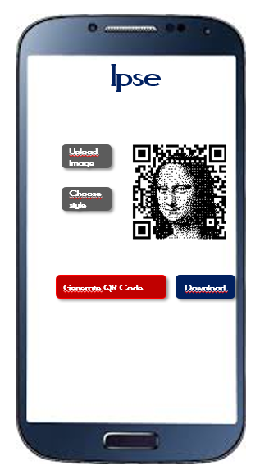

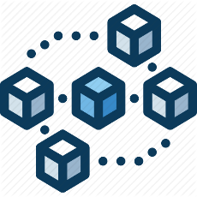
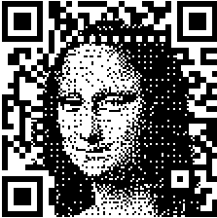
How it works
1
2
3
4
5
User fills in their data
Ipse validates the data with the government
Ipse stores the data on the blockchain via smart contract
User receives notification from Ipse
User generates QR code

Slide 5
Government
Confoirmation/Validation
E-commerce
Social Media
Web services
Any company that requires idnetity
Ipse
User
Library
Identity APP
Internet/Blockchain based
Notes:
Any company/participants that want to participate.

Slide 6
Key Activities
Smart Contract
Library to address smart contract
Ipse
Identity management app
Validation with the government

Slide 7

Ipse
Digital identity
Ipse
First Name |
Upload Image
Last Name
Choose style
Date of Birth
Generate QR Code
Download
Change
Save
Commit
Notifications

Slide 8

Customer/Target Users
Anyone who wants to take the control of their own identity!

Slide 9

Solution for our Partners
Partners use Ipse library to communicate with the smart contract

Slide 10
What makes Ipse special
 | Ipse | UPorte | Open-Zeppelin
App for users | Yes | Yes | No
Library for partners | Yes | No | Yes
Security | High | Very High | Low
Storage

Slide 11
Revenue Model
Fees from Partners
Fees from
Users
or
Based on monthly subscription

Slide 12
Set-up costs
Fixed assets |  | Cost
 | Equipment | $25,000.00
 | Furniture | $10,000.00
 | Fixtures | $5,000.00
 | Other | $10,000.00
Total fixed assets |  | $50,000.00
Initial costs (before opening) |  | Cost
 | Legal and Tax | $150,000.00
 | Marketing | $200,000.00
 | Software Development | $200,000.00
 | Management and Executive | $300,000.00
 | Other Administrativ | $50,000.00
 | Fund Management | $50,000.00
 | Strategic Partnerships Building | $100,000.00
 | Initial advertising | $0.00
 | Other | $10,000.00
Total initial costs |  | $1,060,000.00
Total funds for setup |  | $1,110,000.00

